Slide 1

Titanic Survival Prediction Project
A Comparative Analysis of Classification Models
By: Mithilesh Satta
Tech Stack: Python, Scikit-Learn, Pandas

Slide 2

Project Objective
Challenge: The Titanic shipwreck is one of history's most famous tragedies.
Goal: Predict passenger survival using machine learning based on socio-economic status, age, gender, and more.
Dataset: Kaggle Competition Data (891 Training Samples)
Why it matters: It is a classic problem for mastering data cleaning, feature engineering, and binary classification.

Slide 3
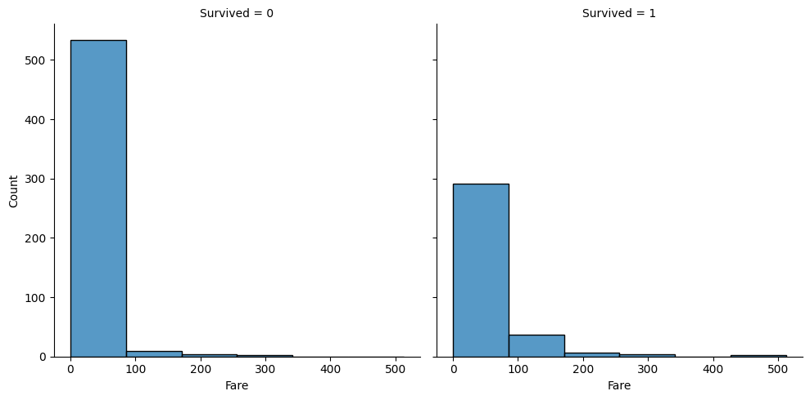
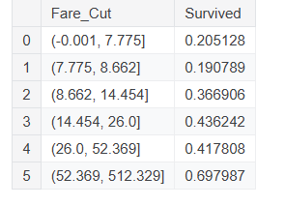
Exploratory Data Analysis
Gender: Female survival rate (~74%) vs. Male (~18%).
Correlation: Visualized that "Small Families" (1-3 members) survived more often than those "Alone" or in "Large Families.“
Class: Pclass 1 (Upper) had highest survival; Pclass 3 (Lower) had lowest.

Slide 4
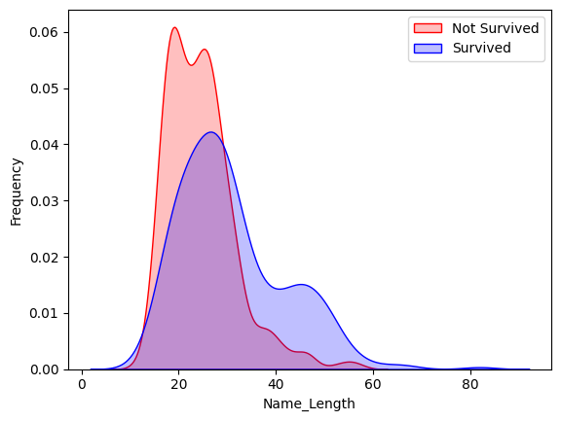
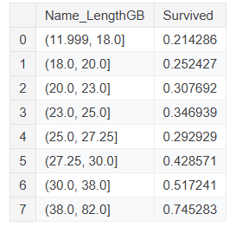
Feature Engineering
Highlighting custom features created to boost accuracy:
1.Name Titles: Extracted "Mr", "Mrs", "Miss", "Master" from names. Grouped rare titles like "Countess" or "Major"
into "Noble/Military."
2.Family Grouping: Combined Sibling and Parent counts into a single "Family Size" metric.
3.Binning: Converted continuous variables (Age, Fare) into ordinal bins (Categories 0-7) to reduce model noise
and prevent overfitting.

Slide 5
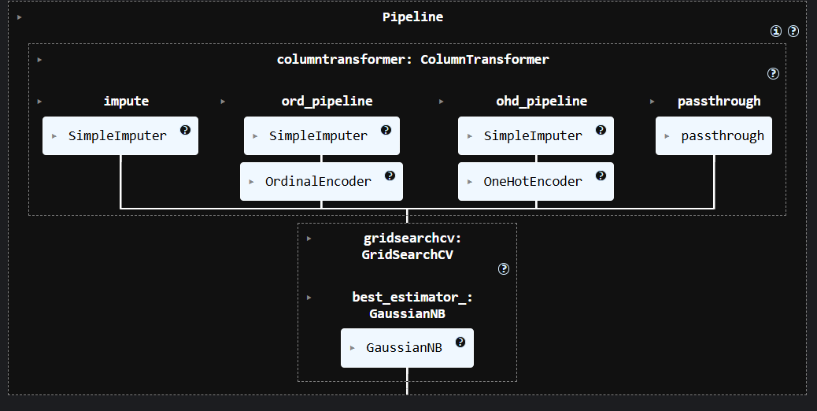
The Machine Learning Pipeline
Visual representation of the workflow:
1.Imputation: Filling missing Age/Embarked data.
2.Encoding: Converting text (Male/Female) to numbers (0/1).
3.Transformation: Using ColumnTransformer to process all features at once.
4.Reasoning: Ensures data processed in training is identical to testing data.

Slide 6
Models & Tuning
Models Tested: Random Forest, Decision Tree, KNN, SVC, Logistic Regression, Gaussian Naive Bayes.
Optimization: Used GridSearchCV
What it does: Tests thousands of combinations of settings (hyperparameters) to find the mathematically "best“
version of each model.
Validation: Used Cross-Validation (5-folds) to ensure the model wasn't just memorizing the data.

Slide 7
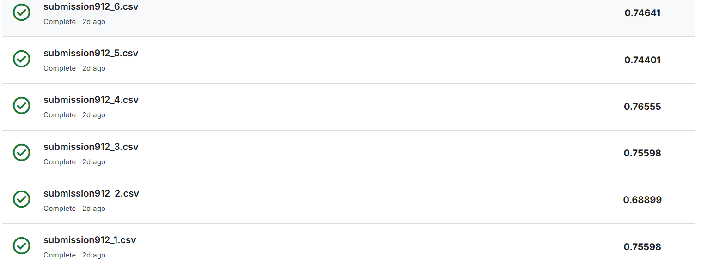
Results & Conclusion
Top Performer: Random Forest Classifier (or whichever scored best for you).
Accuracy Achieved: ~78-82% (Validation Score).
Future Improvements: Could further analyze ticket prefixes or use Ensemble methods (combining models).
Closing: "This project demonstrated the importance of feature engineering over raw data processing."

